Slide 1
Big Questions
Big/Essential Questions:
Questions that pertain to our lives that can be answered or discovered by looking at the themes or big ideas presented in literature.
This is why we read literature! Through literature we can understand our world better and we can try to answer the BIG questions about life.
What are our “BIG” Questions from the transcendentalist texts we have read so far?
For each text below write the big idea or message of the text, then come up with one question the text could be helping us to answer.
Walden
Self-Reliance
Resistance to Civil Government
Death of an Innocent

Slide 2
The Dark Romantics
Challenge to the Transcendentalists

Slide 3
Who Were the Dark Romantics?
The Dark Romantics were a group of nineteenth-century writers who explored the dark side of human nature.
Dark Romantic writers explored the human potential for evil, including the psychological effects of guilt, sin, and madness.
The Dark Romantic view countered the optimism of the Transcendentalist writers of the time.
They were often called anti-transcendentalists

Slide 4
Differences Between Transcendentalists and Dark Romantics
Transcendentalists
Dark Romantics
Saw divine goodness and beauty beneath everyday reality
Believed spiritual truths may be ugly or frightening
Embraced the mystical and idealistic elements of Puritan thought (everyone has potential to be good/perfect)
Reintroduced the dark side of Puritan beliefs: the idea of Original Sin and the human potential for evil

Slide 5
Similarities Between Transcendentalists and Dark Romantics
Transcendentalists
Dark Romantics
True reality is spiritual.
Intuition is superior to logic or reason.
Human events contain signs and symbols of spiritual truths.

Slide 6
Dark Romanticism
Focus on the tragic rather than the optimistic.
Characters are:
prone to sin
mental aberration
self-destruction
Do not inherently possess divinity and wisdom
(A Transcendental Thought)
Nature:
cruel and to be feared
not admired.
when they reveal a truth about man, its revelations are evil and hellish.
Shows individuals failing in their attempts to make changes for the better.

Slide 7
Nathaniel Hawthorne (1804–1864)
Hawthorne’s short stories and novels reflect Dark Romantic views of humanity.
In “Dr. Heidegger’s Experiment,” four people drink a magical elixir and choose the foolishness of false youth over the wisdom of age and experience.
In “The Minister’s Black Veil,” a Puritan minister decides to wear a black veil for the rest of his life to represent the universality of sorrow and secret sin.
The novel The Scarlet Letter tells a story of sin and redemption and explores the evil of hypocrisy.

Slide 8
Herman Melville (1819–1891)
Herman Melville’s short stories and novels also reflect a Dark Romantic view of nature and humanity.
In the novel Moby-Dick, Captain Ahab doubts whether there is any real truth or meaning behind the appearances of nature.
In “Bartleby the Scrivener,” a lawyer watches his copyist withdraw completely from the material world.

Slide 9
Edgar Allan Poe (1809–1849)
Poe’s masterful short stories told tales of madness, revenge, and tragic fate.
In “The Cask of Amontillado,” the mad narrator takes deadly revenge on a man who insulted him.
In the classic horror tale “The Pit and the Pendulum,” the narrator barely escapes a horrible death in a dark dungeon.
In “The Tell-Tale Heart,” a man commits murder and is driven to confess by the imaginary beating of the dead man’s heart.

Slide 10
The Dark Romantic Legacy
Dark Romantic themes still appear in stories, books, movies, TV shows, and comic books.
Present-day horror stories and movies borrow images and themes from the original master of horror, Edgar Allan Poe.
The conflict between good and evil and the effects of guilt and sin are major themes in current literature, popular writing, and television.

Slide 11
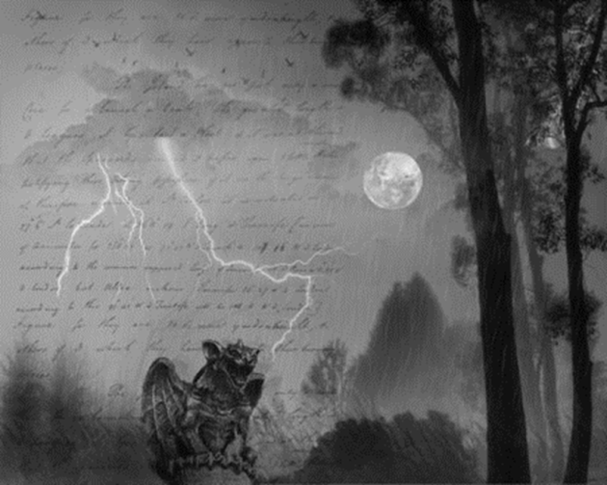
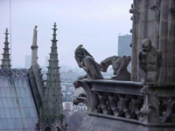
Gothic Literature (a more specific type of Dark Romanticism)
Gothic images include castles, lightning, rain, thunder, darkness, gargoyles, sharp points, brick buildings, and steep roofs.
Setting is very important in gothic literature. It creates the mood of the story. Writers: Poe (master of gothic lit.) and Hawthorne,

Slide 12
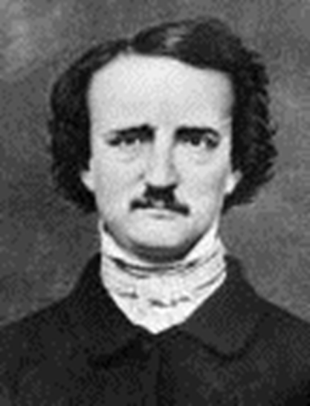
Edgar Allan Poe: father of the gothic short story
1809-1849
Orphan at the age of two. He was taken in, but never adopted.
Went to the University of Virginia, but dropped out because he gambled $2,000 away.
Went to West Point Military academy, but was expelled.
Was an editor, but was fired.
Was a literary reviewer, but he was very harsh and mean towards the author’s writing

Slide 13
POE
Poe wrote and was published during his life; however, it was not enough money to live a fulfilling life.
Poe found the love of his life, Virginia. She was his cousin. They married when she was thirteen. She died at age 25 from TB.
Poe began to drink.
Died in 1849.
Father of the short story, horror story, and detective story. Wrote about love, lost love, revenge, terror, and insanity.

Slide 14
Transcendentalism vs. Dark Romanticism
Review your notes and answer the following question:
Are you more of a dark romantic believing that the world has a dark irrational side that can’t be ignored?
Or are you more of a transcendentalist who is optimistic about the world and sees human perfectibility as an attainable goal?

Slide 15
“The Fall of the House of Usher”
Objectives: We are reading this story to understand mood and to look into the aspect of a reliable vs. unreliable narrator
Define: Mood (what is mood in literature? How does an author set a certain mood?)
Mood: The general atmosphere created by the author’s words. It is the feeling the reader gets from reading those words. It may be the same, or it may change from situation to situation
***Reliable/ unreliable narrator (what makes a narrator reliable vs. unreliable? Can you think of any examples from literature/movies?)

